Slide 1
Academic Rep Training
SSLC Campaigns

Slide 2
What is a campaign?
An organised effort to enact tangible change to environments, policies, laws and systems…
  These changes are typically in the interest of a social or economic group in service of a political project
  Generally, campaigns encompass mobilising, advocacy, lobbying and creating initiatives
In order to understand which tools to leverage, its important to identify what the nature of your campaign is: is it an institutional or grassroots campaign?

Slide 3
Institutional or grassroots?
What is the definition of an institutional campaign?
  An institution refers to a large and important body, this body will contain a formalised structure, its own strategic goals and a defined strategic objective
  Institutional campaigns take a top-down approach beginning with individuals situated within an organisation … the campaign is typically executed on behalf of the organisation and work is largely taken up within the organisation
What is the definition of a grassroots campaign?
  Grassroots refers to a bottom-up, people-powered approach
  Typically a grassroots initiative or campaign will rely on volunteers

Slide 4
How do you begin
a campaign for your SSLC?
How do you begin a campaign for your SSLC?
  Identity your campaign goals
  Identify tangible measures of success
  Identify your community
  Identify your base
  Identify who you are lobbying to

Slide 5




Assessing your network
You have identified your community, base etc, however it’s important to assess what your relationships with these various groups look like now
  This will foster a better understanding of what is needed and how to strategise effectively given your circumstances

Slide 6
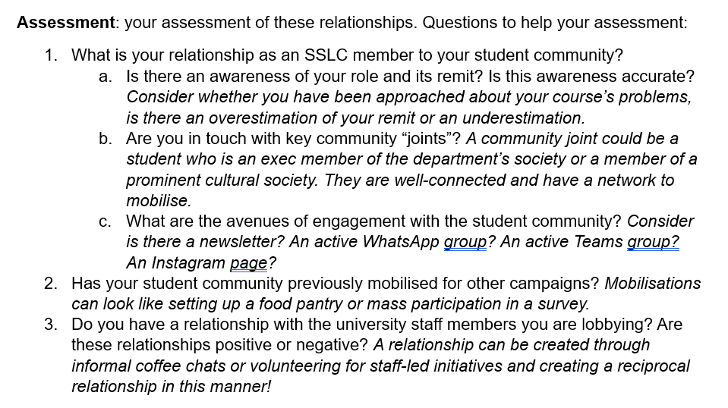
Assessing your network
  Questions to ask yourself

Slide 7
Launching the campaign
Outline your phases:
  The first phase should focus on relationship building and consciousness-raising around the campaign – relationship building can look like a coffee chat, holding workshops and socials for your various bases
    It is essential to consolidate these relationships
  The next phase is accelerating the campaign, make your demands clear
  After this point the campaign is live
  Pressure can be applied after this point when there is a lull

Slide 8
Key takeaways:
- BUILD RELATIONSHIPS
- RESEARCH
- ISSUE DEMANDS
- APPLY PRESSURE
- WIN
Notes:
Academic / personal – what matters?

