Slide 1
Welfare Exec Training
Warwick Students' Union Clubs and Societies
Content Warning: Discussion of Mental Health, Suicide, Sexual Violence and Harassment
07/10/2022

Slide 2


Understanding your role
A WELFARE OFFICER IS...
A WELFARE OFFICER IS NOT...
An approachable figurehead within your club / society.
Ensuring inclusivity and accessibility
As involved as you decide
A signpost
A Counsellor
A Professional
Responsible for the feelings of your members

Slide 3
What does this mean in practice?
Signpost your members to wellbeing services.
Make sure your members are aware of your role.
Promote an open environment to discuss and support positive mental health in your activities.
Help to make your activities inclusive.
Welfare officers are not expected to act as therapists, crisis workers, a 24/7 source of support or be responsible for their members’ health.

Slide 4
Proactive & Reactive Support
Being proactive
Being reactive
Introduce yourself and your role to new and existing members.
Family/buddy schemes are a great way to pair up new and existing members for both social and mentor-style support.
Familiarise yourself with the services available to you through the SU and the University.
Sometimes people will disclose to you issues, concerns or incidents which are affecting their welfare.
Try to remain impartial, open, and supportive in situations which may arise.
Respect that some situations are personal, and keep them confidential unless you have permission from the person, or are referring them to a service.
See Report and Support advice on receiving disclosures.

Slide 5
Presidents
Inherently a position of power - be conscious of this.
If you have a separate Welfare Officer on your exec:
Make sure to delegate
Respect that some issues don't benefit from having the head of the society/club involved.
If you hold both positions:
Have a contingency for situations where you might have to step aside – is someone else on the exec happy to step in?
It can be intimidating to approach "The President" of your club or society – is it worth reaching out proactively to show you're approachable?
Be prepared to switch hats when necessary.

Slide 6
Signposting
Wellbeing Support Services
Student Opportunity
Students Union Advice Centre and Student Officers
Residential Community Team
Community Safety Team
Personal Tutor System, Dean of Students/Faculty Members
Health Centre
Local Police / PCSO
SDVA (via Wellbeing Support)
Report and Support
Chaplaincy
Online Resources / 'Togetherall'

Slide 7
You have noticed that one of your regular teammates / members hasn’t shown up to training / a regular event recently and when you see them on campus they seem flippant and disinterested. What would you do?​

Slide 8
Possible solution:
Approach them and see how they’re getting on. You can chat to them about something that might get their mind off how they feel, let them know they can chat to you later, or signpost them to other services. Remember your role isn’t to act as counsellor, so try to signpost on where you can.
You have noticed that one of your regular teammates / members hasn’t shown up to training / a regular event recently and when you see them on campus they seem flippant and disinterested. What would you do?​

Slide 9
There’s been a controversial incident within your club / society, which has led to disciplinary action from the Union and many members being upset by the incident. What would you do?

Slide 10
There’s been a controversial incident within your club / society, which has led to disciplinary action from the Union and many members being upset by the incident. What would you do?
Possible solution:​
Ensure any affected members are well, and have been made aware of the relevant services available to them. Speak to your group and outline that your club / society do not condone the inappropriate behaviour, and that there are support mechanisms in place to help anyone who has been affected.

Slide 11

Creating an inclusive environment
All eligible members of the Students’ Union must be able to join your club or society, and stand for election for any position on your exec. Some exceptions include visiting or associate members, who can’t stand for election to your exec, or legitimate specifications for an exec role outlined in your constitution and approved by the societies committee.
Aim to eliminate any barriers to accessing your club or society, and don't prevent participation due to a protected characteristic.
A safe space free from discrimination for all of your members.
Over the year it’s normal to become a group of close friends, but remember to include new people, and people who aren’t a part of your friendship group. Everyone deserves an equal opportunity to take part.

Slide 12
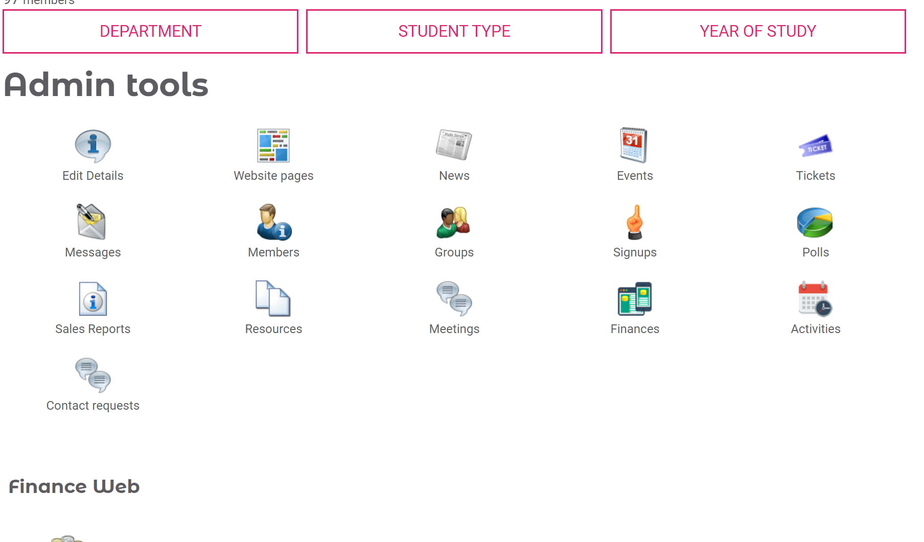
Demographics of your club/society
Have a look at your membership. Who doesn’t engage with your group? Do you think your activity is inaccessible to any particular group of students?
How can you tackle the barriers that stop students taking part?
You can run taster sessions, run activities for under-represented groups, or collaborate with other clubs and societies to reach a wider variety of students.
Some groups might be better able to take part in your activities if you make small adjustments such as changes to your messaging.
Exec Dashboard Update

Slide 13
Undergraduate
Postgraduate Research
Postgraduate Taught
Overseas (non-EU)
Rest of EU
UK (home) students
Minority Faith Groups
Disabled students
Black and Minority Ethnic Students
LGBTQ+ students
Women
Parents and carers
Mature and part time students 
Live at home students
What does the Warwick student body look like?

Slide 14
Postgraduate Students
BAME Students
International Students
Run one-off drop-in sessions. This will help postgrads get involved when their schedule allows. Run postgraduate only sessions. This could help postgrads feel more comfortable joining in to start with, before taking part in more sessions.
Elect a Postgraduate Officer.
Consult our VP for Postgraduate Students Hamza Rehman at postgrads@warwicksu.com
Run taster sessions.
Try to avoid technical terms, and imagine students have no idea what you do!
Are there any groups that might be particularly interested in your club or society? Run a joint session to help increase interest in your group.
Work with our International Students’ Officers (EU + Non-EU)
Ask to collaborate with relevant cultural societies.
Are there any societies that might be particularly interested in your activity? Can you run a joint event or initiative to increase your membership?
Collaborate with our Ethnic Minorities Officer Maisha Hassan at ethnicminorities@warwicksu.com

Slide 15
Women
LGBTQUA+
Students
Socio-economic background
Consider running female only sessions. This could help women feel more comfortable joining in with your activity to start with, before taking part in more sessions.
Ask to collaborate with other societies/clubs with a relevant focus or membership.
Work with our Women’s Officer, Enaya Nihal, at women@warwicksu.com.
Be aware of the language you use – gendered language can make some people uncomfortable.
Ask for and respect people's pronouns and the names they are comfortable with.
Work with our LGBTQUA+ Officer, Jack Bateman, and Trans Students' Officer, Ella Osho, at lgbtqua@warwicksu.com and trans@warwicksu.com.
Make sure at least some of your activities are free or affordable.
Run free taster sessions. This can help students decide if they want to pay your groups full membership fee.
Collaborate with our Widening Participation Officer, Kieran Barry, at wpo@warwicksu.com

Slide 16
Faith Groups
Disabled Students
Take into account dietary requirements and religious dates.
Run an alcohol-free event, or a celebration event for a religious holiday.
Collaborate with faith-based societies or the Chaplaincy.
For information about the Chaplaincy go to www.warwick.ac.uk/services/chaplaincy
Make your activity accessible. Is your event wheelchair accessible? Have you used large-print copy?
Signpost how members can inform you of any accessibility requirements.
Collaborate with relevant societies.
Work with our Disabled Students’ Officer, Saul Harvey, disabledstudents@warwicksu.com.

Slide 17
Accessibility in Clubs and Societies
Michael Cavaliere on behalf of Autism at Warwick

Slide 18

Someone has a disability if they have a “physical or mental impairment that has a ‘substantial’ and ‘long-term’ negative effect on your ability to do normal daily activities.”
At Warwick, 10.5% of students are disabled.
Some examples of disabilities you may encounter:
  Mobility impairments, such as cerebral palsy or paralysis.
  Visual or hearing impairments.
  Long-term physical health conditions, such as chronic fatigue syndrome or epilepsy.
  Long-term mental health conditions, such as depression or anxiety.
  Developmental disabilities, such as autism or learning disabilities.
  Specific learning difficulties, such as dyslexia or dyspraxia.

Slide 19
Disabled students in societies/clubs
It is important to consider the needs of disabled students in your society/club, including the idea that there may be students with disabilities you aren’t aware of.
  Many students may not be open about their disability or may feel embarrassed or ashamed of needing additional support to access society events.
  Many disabilities are invisible, and even those which are visible may not look how you would expect.
There are two aspects to creating an inclusive and accessible environment in your society:
  Addressing the accessibility needs of individuals.
  Implementing universally accessible measures.

Slide 20
How can I address individuals’ needs?
Be proactive – make society/club members aware that you want to be accessible and encourage disabled members to get in contact to discuss their needs, and ensure that students don’t feel they have to tell you the specifics of their disability to get support.
Keep it confidential – many disabled students, for various reasons, are not comfortable being open about their disability and so it is crucial to keep the information between the exec members who need to know and to make sure the student is comfortable with you telling them.
Keep the conversation ongoing – it is important that accessibility is an ongoing conversation with your disabled members; keep checking in on how they are finding society events and to deal with new scenarios you may not have considered.
Don’t be afraid to ask – most disabled people are happy to be asked respectful questions about their disability, and remember that two people with the same disability often have very different needs, so it is always best to ask the individual.

Slide 21
Some examples of individual needs
Someone with a visual impairment may need a sighted guide to navigate unfamiliar venues.
Someone with autism or a learning disability may need exec members to explain what’s happening at an event again in more detail or in a different way.
Someone with dyspraxia or a mobility impairment may need exercises to be adapted for them.
These are personal to the individual, so could encompass a wide variety of adjustments!

Slide 22
What does universal accessibility mean?
Universal accessibility is about making your society/club accessible and enjoyable for any individual, regardless of disability.
This means implementing measures to ensure that disabled people can access your society/club as standard, rather than waiting for a disabled student to ask.
This has the benefits of:
  Ensuring inclusion of all disabled students, including those who aren’t comfortable disclosing their disability or with undiagnosed additional needs.
  Improving conditions for non-disabled members who may not need these adaptations as a disabled person would, but can still benefit from them being available.
  Helping to prevent discrimination or disability-based bullying by not singling out disabled people.

Slide 23
Some examples of universally accessible measures
Hosting events on the ground floor of buildings or in buildings with lift access.
Providing subtitles for videos or film nights.
Using high-contrast colours and clearer fonts on society emails and newsletters.
Having a quiet space at social events for people to use if overwhelmed.
Providing details of what will be happening at society events ahead of time.
Using image descriptions on social media posts.
Providing breaks in long rehearsals or practices.

Slide 24
Business Disability Forum
This is a place to find lots of resources on disability, inclusion and accessibility.
Primarily aimed at businesses, but has a variety of resources that societies may find useful too.
Any student or staff member at Warwick can sign up for an account for free using their Warwick email address: https://businessdisabilityforum.org.uk/knowledge-hub/account-register/

Slide 25
Takeaway messages
We should all want to make our societies inclusive and accessible to disabled students!
It is important to take a proactive approach to make students comfortable disclosing their needs.
Implementing accessibility measures as standard helps to create a more inclusive environment and stops disabled people from feeling ‘othered’.
If you have any questions, please contact me at michael.cavaliere@warwick.ac.uk

Slide 26
Find out more!
Scope (general disability): https://www.scope.org.uk/
National Autistic Society (autism): https://www.autism.org.uk/
Royal National Institute of Blind People (visual impairment): https://www.rnib.org.uk/
British Deaf Association (hearing impairment): https://bda.org.uk/
Mencap (learning disabilities): https://www.mencap.org.uk/
Mind (mental health conditions): https://www.mind.org.uk/
Aspire (spinal cord injury): https://www.aspire.org.uk/
Headway (brain injury): https://www.headway.org.uk/
ME Association (chronic fatigue syndrome): https://meassociation.org.uk/
British Dyslexia Association (dyslexia): https://www.bdadyslexia.org.uk/

Slide 27
Welfare Exec Training- 2022
Jemma Ansell –
Student Liaison Manager

Slide 28
Why are we here today? – Principles.
We treat everyone with respect.
Joint Advisory Group
discussed, consulted and concluded 5 Principles.
These set out our values and expectations of how we behave as
a University community, both as individuals and as an institution:
We do not tolerate discrimination.
We do not tolerate Sexual Misconduct, Violence or Abuse.
We keep our campus + community safe.
“We” means all of us, students and staff alike.
In July 2019, the University of Warwick’s Independent
External Review, by Dr. Sharon Persaud was published.
All 30 of her recommendations were accepted.
Notes:
Emphasis on ‘staff and students alike’ here
Highlight that these principles form the basis of all we do

Slide 29
What incidents are being disclosed?
Academic year 2021/22
Academic year 2020/21
Notes:
Faculty of Science, Engineering & Medicine: 103 disclosures in 2020/21, 80 from students, 22 from members of staff
Bullying, Harassment & Sexual Misconduct being most prevalent

Slide 30

Conferring belief is vital.
SAFETY
Immediate danger?
On campus: Community Safety Team - 024 7652 2222 Off campus: Emergency Services - 999
Get them to a safe, calm space.
LISTEN
Give them space – physical contact may be too intrusive.
Reflective Listening – relay what they have said and give them time to speak.
If they do not want to talk about it in that moment in time, that is okay.
BELIEVE
Ensure that they are understood and that you believe them.
Ask open, not closed questions
Self-doubt, shame and ultimately fear of not being believed are barriers to disclosure.
SUPPORT
Signpost: Report + Support ISVA / Wellbeing / SARC
Offer continual support. This could be practical or emotional.
Check up on them.
Top Tip: when receiving a disclosure, it is essential to set realistic expectations.

Slide 31
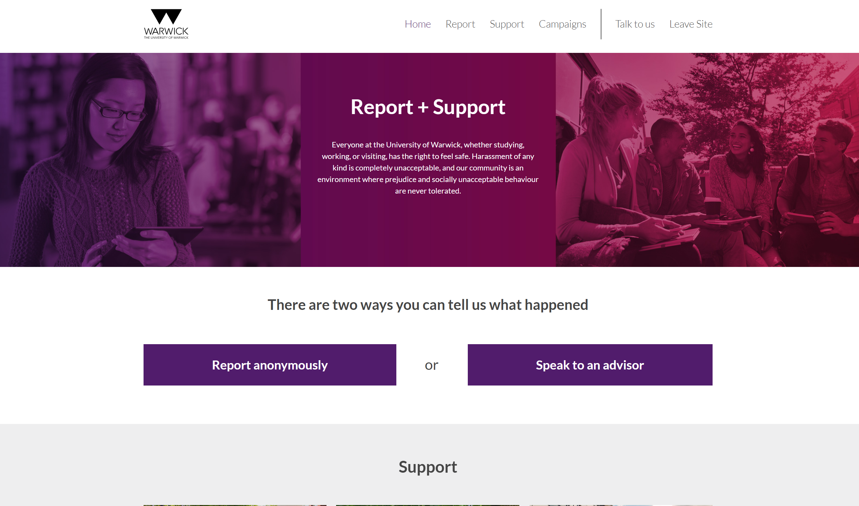
Hello and welcome to the template
The block device can be added by copying, pasting then resizing to fit

Slide 32

reportandsupport.warwick.ac.uk
SINGLE GATEWAY TO DIRECT HELP
Online Reporting Platform for students and staff affected by: Bullying and Harassment Discrimination Hate Crime Sexual Misconduct Recognises intersectionality.
DISCLOSING
Anonymous Reporting Reporting with Details Accessing Support Pages Does not trigger formal complaints process. Can report something that you witness. Can assist someone in reporting.
LIAISON OFFICER
Confidential Empower reporter to make an informed decision on their next steps – they are not forced to do anything. Can provide practical and signpost to emotional support. Single point of contact.
SUPPORT PAGES
Online support pages available to everyone whether someone wants to disclose or not: If you ever forget what you’ve learnt today, return to these pages for guidance! Fully outlines options and processes
Remember, reporting through Report + Support does not trigger a formal complaints process.

Slide 33
Why Use Report and Support?
Many exec members try to support or ‘handle’ disclosures that they receive from members themselves.
Whilst individuals’ intentions are often positive, handling serious and potentially criminal allegations takes time, expertise and often impartiality.
University policies, principles and values override all club code of conducts. | Accidental destruction of evidence or first accounts. Convolution of evidence/ investigation. | Confidentiality is key. Inability to be impartial. | Repeat disclosures. | Lack of signposting and access to specialty services. Looking beyond university and the impact the incident may have. | Poor handling of disclosures can often lead to SU or University complaints against Exec members. E.g. Trial by social media.
Notes:
Highlight here – this demonstrates the broad range of behaviours which come under the term ‘sexual misconduct’, all of which are taken seriously and come under the aforementioned policy

Slide 34
University Disciplinary Process- SLO as single point of contact.
REPORTING PARTY
Assigned a Student Liaison Officer within 2 University Working Days. Options outlined and supported in submitting a Stage 2 Formal Complaint. No Contact Agreement or Precautionary Action. Accompanied/ Supported in the interview and investigation process. Accompanied/ Supported at the Disciplinary Committee. Accompanied/ Supported in Mitigation Committee. Accompanied/ Supported throughout an appeal (if necessary).
RESPONDING PARTY
No Contact Agreement or Precautionary Action. Accompanied/ Supported in the interview and investigation process. Accompanied/ Supported at the Disciplinary Committee. Accompanied/ Supported in Mitigation Committee. Accompanied/ Supported throughout an appeal (if necessary).
Support
Emotional, academic, housing, financial, social and careers support are just a few examples of how SLOs support both parties alongside a disciplinary process.
Notes:
IMPORTANT: Anonymous disclosures mean we cannot do anything. If an individual, staff or student wishes to disclose, they must select ‘speak to an advisor’ when reporting to ensure that we can do as much as we can to help – whether that be through support or initiating a complaint.

Slide 35
But What If?
They choose to do nothing
They don’t want to report it
Only you know
You know everyone involved
It begins to affect you

Slide 36
Boundary Creep: ‘What are your red flags?’
Feeling anxious when you are about to meet or open an email from a particular student?
Worrying about a student / students when you are not at work?
Feeling emotional/upset after you have spoken to a student?
Feeling guilty that you can’t fix a student’s problems?
Communicating with a student outside of working hours?
Notes:
Generally speaking, boundaries become blurred over time – and we may not always notice when it is happening. Sometimes, a series of seemingly small interactions with a student or students can collectively represent a major boundary breach. In Wellbeing Support, we regularly speak to members of staff who have reached a stage where the level of support that they are providing to a student or students is very significantly impacting their wellbeing – both inside and outside of the workplace. They often report that the situation escalated over a number of weeks or months, and that they didn’t realise that they were operating outside of their boundaries until they finally asked for help. Learning to recognise the signs that your boundaries may be becoming blurred before things reach this stage is a useful skill.

Slide 37

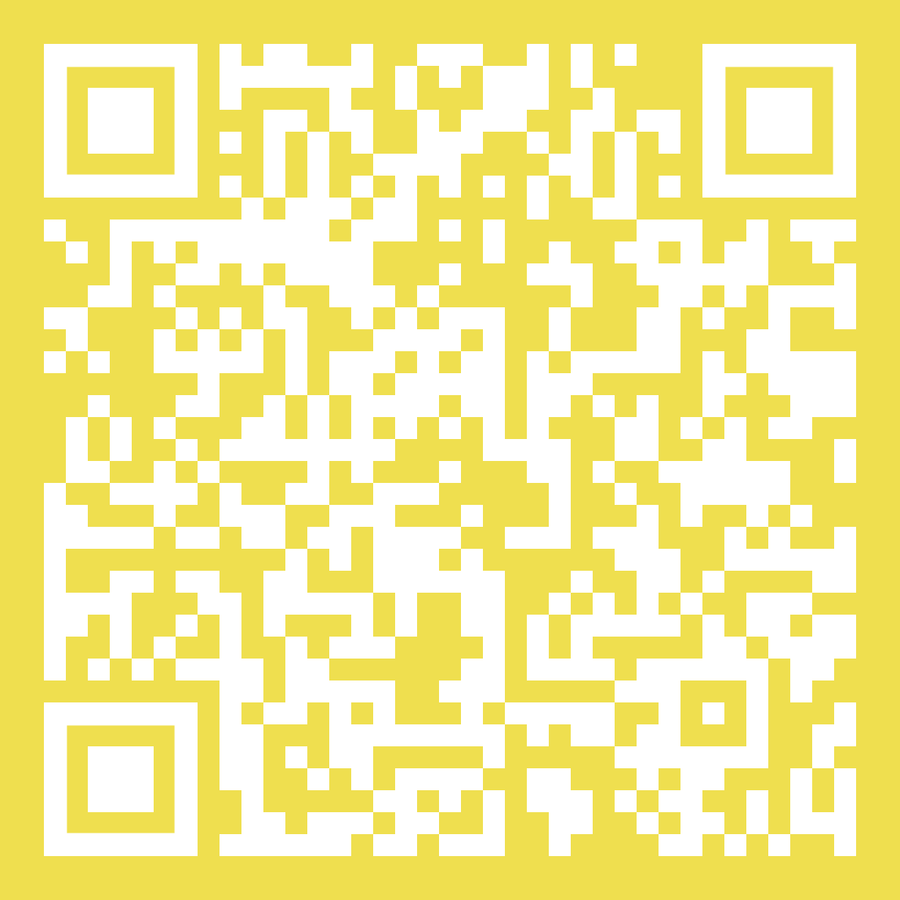
https://reportandsupport.warwick.ac.uk/campaigns/report-and-support-ready
We have 23 Clubs so far that are Report + Support Ready for 2022/23.
Table Tennis, Cycling & Triathlon, Athletics and Cross Country, Shotokan Karate , Lifesaving, Badminton, Tennis Club, Women’s Netball, Men's Football Club, Mixed Netball, Taekwondo, Archery , American Football, Men's Rugby Union, Mixed hockey, Handball, Latin & Ballroom Dancesport, Women's Cricket, Men's Hockey, Women's Football Club, Ladies' Hockey and Sailing.

Slide 38
https://reportandsupport.warwick.ac.uk/campaigns/report-and-support-ready
EAAA – FLIP THE SCRIPT
ALL women welcome.
12 hours of interactive training. Must be able to attend all 12 hours.
20 spaces per workshop.
Dates:
15.00-18.00: 25th and 26th October, 1st and 2nd November.
10.00-17.00: 7th and 8th November.
Excusive sign up invitation to clubs/ societies who have completed Are you Report and Support Ready?
Assess: Recognise risk cues for sexual and gender based violence in situations.
Acknowledge: Identify and overcome personal obstacles to prioritising your own sexual rights acquaintance situations.
Act: Develop a toolbox of both physical and verbal strategies to defend your body and boundaries.

Slide 39
Training Available
Warwick Values Moodle
Active Bystander
Report & Support Awareness Training
General & Specialised Consent Training
Flip the Script
Maskulinity Project
Are you Report and Support Ready?
Collaborations
The Report and Support Team frequently mark relevant awareness days with events, workshops and training sessions. If you are planning an event centring on any forms of harassment PLEASE GET IN TOUCH: reportandsupport@warwick.ac.uk

Slide 40
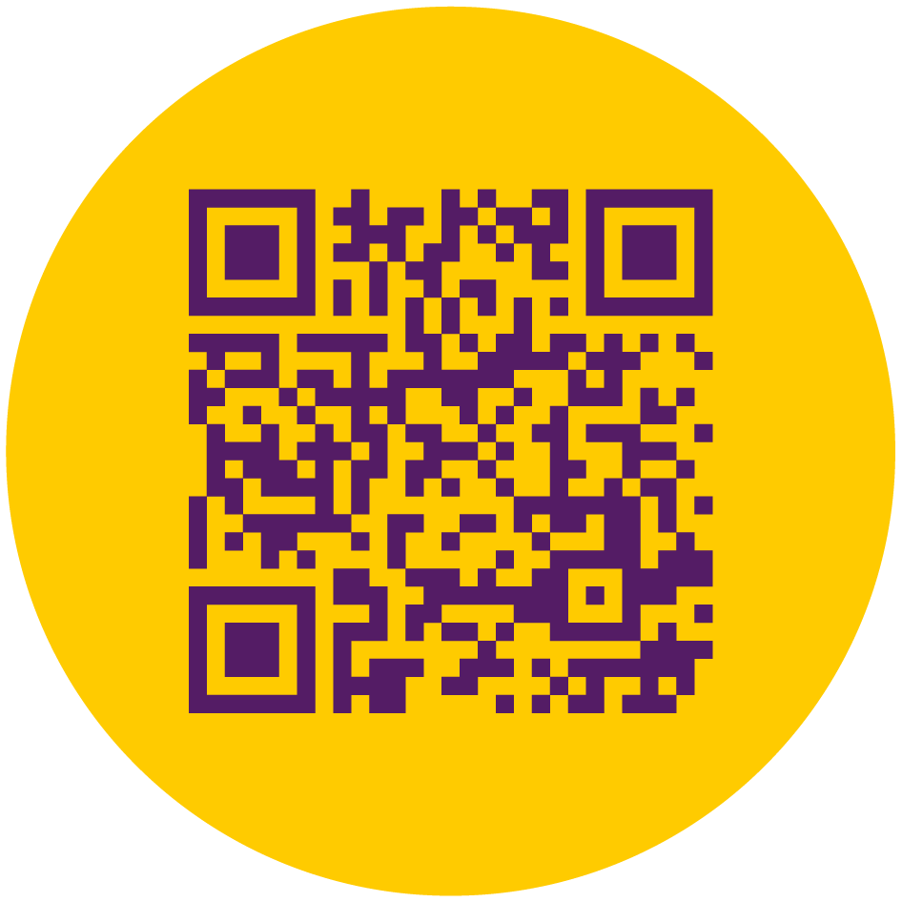

Any questions?

Slide 41
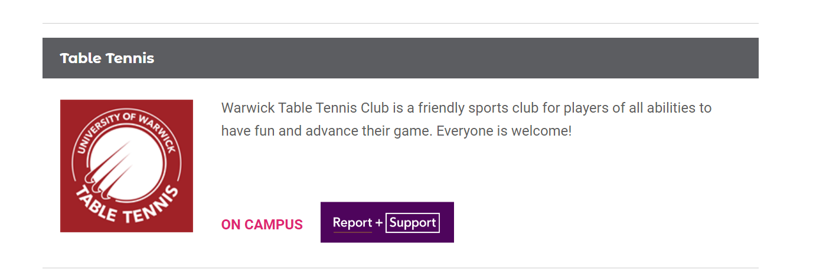

Slide 42
Papyrus Training!
https://www.papyrus-uk.org/training/sp-eak-warwick-su-3/
Tues 11th October: 12:30-2:30pm

Slide 43
Any questions?
Contact us!
Anna Taylor (VP for Societies) - societies@warwicksu.com / anna.taylor@warwicksu.com
Emma Birch (VP for Sports) - sports@warwicksu.com / emma.birch@warwicksu.com

