Slide 1
Student Activities and Student Voice!
Training 2023

Slide 2
Student Voice Team
Yaz Yeahia (Student Voice Manager)
James Morrison (Student Voice Advisor)
Daniel Docherty (Student Voice Advisor)
Celine Al-Saleh (Student Voice Advisor PG & International)
Notes:
Add emails

Slide 3
Today’s Session
Understanding how the SU’s Membership Team can support you with:
Organising and running elections!
Societies and Sports Committees!
Setting up your society’s structure!
Constitutional matters!
And much more!

Slide 4
Glossary
Returning Officer
Quorum
RON
Plaintext Manifesto
STV
Articles of Association
Regulation 9
Motion
Ratification

Slide 5
Glossary
Returning Officer – an impartial official to run and approve the vote count of an election
Quorum – the number of votes cast for an election to be valid
RON – Re-Open Nominations, a candidate that if successful would rerun the election
Plaintext Manifesto- an accessible version of your manifesto for screenreading software
STV – Single Transferrable Vote, an alternative voting system the SU uses
Articles of Association – the SU’s governing documents that bind our structures together
Regulation 9 – the official regulations surrounding the SU’s relationship with clubs and societies
Motion – a formatted proposal from a student submitted to Student Council to enact change
Ratification – the process of approval by a higher body

Slide 6


Slide 7

Elections!

Slide 8
Exec Elections
Every club and society must hold annual elections where all exec are elected
This excludes representative roles, which can be co-opted but do not sit on exec
Any member can stand for any position (unless they are associate / honorary members)
Term 2 Week 9 deadline for exec elections

Slide 9
Submit an Election (warwicksu.com)
We can do this for you!

Slide 10
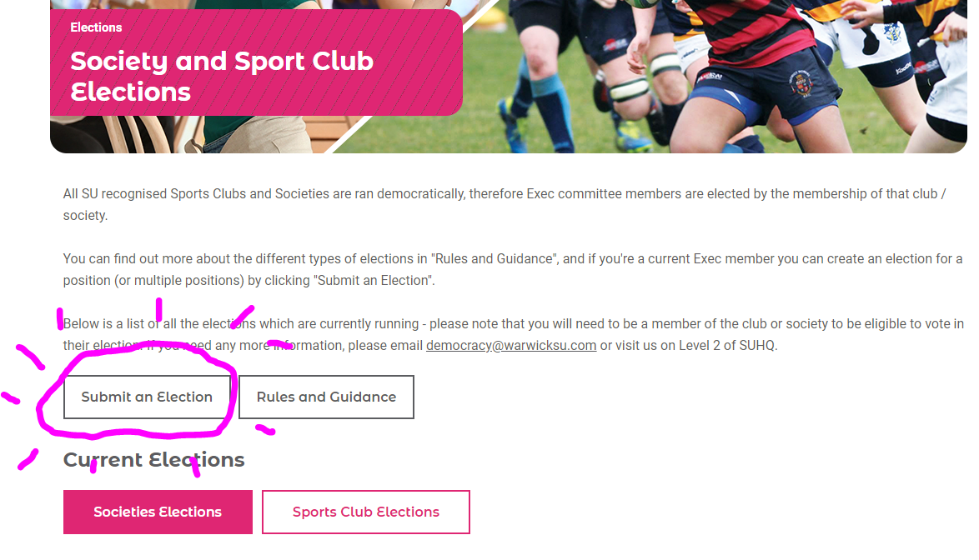

Slide 11
Elections
Rules for elections
Nominations must be at least 7 days, and voting must be at least 48 hours
Please provide proof that the election was legitimate – this is now on the website and in handover packs
Ties

Slide 12
Derecognition
Procedure
Nobody wants this!
If a club or society does not elect a full core exec it is at risk of derecognition
This also applies for unproven elections
Handover packs!

Slide 13
Constitutions!

Slide 15
Society Constitutions / Admin
Society Constitutions:
Can be overridden by anything in Regulation 9 and Articles / Code of Conduct
Core exec are President / Treasurer / Secretary
Should cover Club / Society’s name, aims, objectives, recognition of SU, and affiliations
Any changes should be made in an AGM then approved by Socs / Sports Forum

Slide 16
Forums!

Slide 17
Forum Membership
15 Members:
VP Societies / VP Sports Respectively and a member of Staff
13 elected members
Reserved places for PGR/PGT students
Elected in Summer and Autumn
SU Staff Member as administrative support

Slide 18
Functions of Sports / Societies Forum
New Club / Soc applications
Ratifies constitution changes
Procedural applications
Awards
Student Council
Motions
Other procedural matters

Slide 19
Key Dates
Election Period around Term 2 Week 9
Handover Pack Deadline Term 3 Week 7
We will be in-contact in Term one to inform you of Key election dates

Slide 20
Any questions?
Democracy@warwicksu.com

