Slide 1
Managing Conflict and Escalations
Warwick Students’ Union
Collaboration with the SU’s Learning & Development team
June 2023
Executive Training

Slide 2

Agenda
What we mean by conflict?
Sources of conflict
Myths about conflict
Impact of not resolving conflict
How to resolve conflict and de-escalate
Activity
Notes:
Run through agenda
1 minute

Slide 3
Learning Outcomes
Understand what conflict is and types of conflict
Where do sources of conflict come from
4 step process to managing conflict and de-escalating
Notes:
By the end of this session you will have a better:
Understanding of what conflict is and type of conflict
Where do sources of conflict come from
4 step process to managing conflict and de-escalation
1 minute

Slide 4


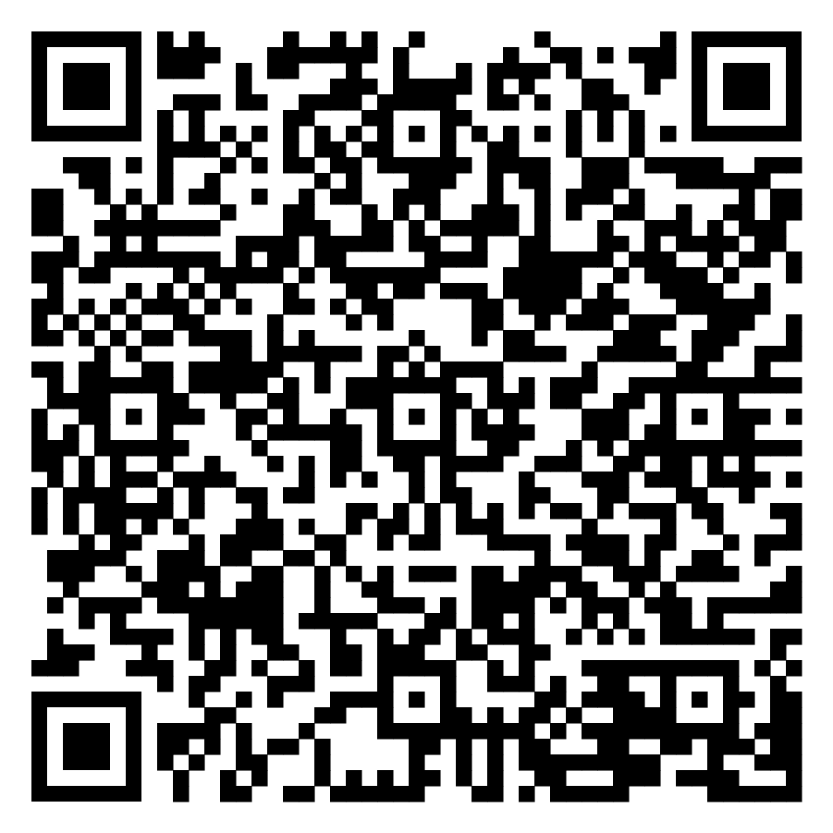
What do we mean by conflict?
Conflict is an active disagreement between people with opposing opinions, or principles (Cambridge Dictionary, 2023).
What do you associate with conflict?
Notes:
By definition, conflict is defined as an active disagreement between people with opposing opinions or principles.
Conflict means different things to different people and there are various types of conflict. In basic terms conflict is a serious disagreement or argument.
Conflict usually happens between people when they have different opinions on things. A conflict can happen between two people or between groups of people, for example between you and your best friend, or within a group of people at work or University.
Conflicts are inevitable in a person’s day-to-day life. And when they happen, the idea is not to try to prevent them but rather to resolve and manage them in an effective manner. When people use the appropriate tools of resolution to address issues, they will be able to keep their differences from rising to major problems.
Activity for the group: ask them to identify what they associate with conflict (e.g anxiety, distress, fear, stress, hurt).
2 minutes

Slide 5
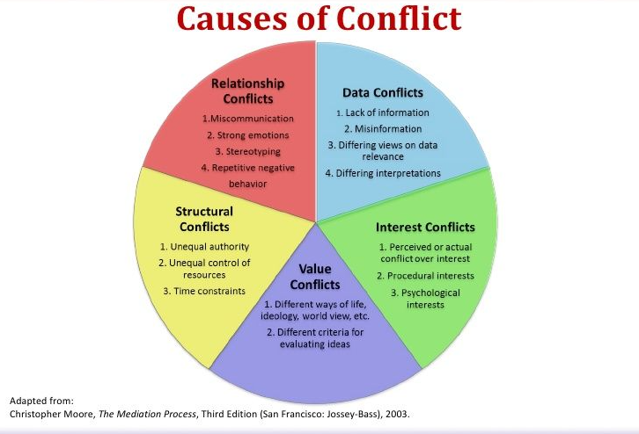
Sources of conflict
Notes:
There are various sources of conflict
Run through the wheel.
3 minutes

Slide 6

Myths about conflict
Having conflict in a team is bad
We need to fix the conflict
We need to identify the good person and the bad person
Notes:
When it comes to workplace conflict, some myths hold sway.
Myth one: conflict is a bad thing. That means someone’s going to suffer and no good will come of it. When we asked earlier about what you associated with conflict, many of you stated (….). But conflict is not always a bad thing. Conflict can be a door to creativity, identifying new ways of thinking, developing greater self-awareness, deeper understanding of others, and stronger relationships. To make the most of these opportunities, we need to take time to reflect on and explore our conflicts, either on our own or through conversation. If our attitude towards conflict is overwhelmingly negative, we’re unlikely to do this.
Myth two: there’s a good person and a bad person. We must figure out who is who and take sides accordingly. When we stop to think about it, we know things aren’t that simple. Any mediator will tell you that, in most disputes, both sides see themselves as victim. This kind of binary thinking causes two problems. Firstly, it exacerbates the conflict and multiplies the suffering. By assuming the existence of a right and a wrong, we condition ourselves to notice only those things which validate our prejudices. This hardens our feelings against whomever we have cast as the perpetrator and reinforces the righteousness of the victim. The second problem is that binary thinking shuts the door to the creativity and learning described above. When we’re busy pointing fingers and defending our truth, it’s harder to notice areas of shared interest that might form the basis for a creative way forward. It’s also far harder to access the humility we need to acknowledge our blind spots and gain self-awareness. In order to move beyond this mindset, we need to develop curiosity, humility, openness and empathy. We need to train ourselves, even in the heat of conflict, to hold back on making judgements, and to hold out for a broader perspective.
Myth three: your job as executive is to fix conflict. This is not necessarily true in conflict. As executives, you may be able to fix many of things your members or teammates bring to you, especially in the case of technical or practical problems. But when it comes to conflict, the urge to fix people’s problems can be misplaced. By imposing a solution on people, you may be robbing them of the opportunity to learn and feel ownership over a solution. Your role as executives is to support people in reaching their own, self-determined outcomes. One way to do this is by facilitating an environment in which they can communicate with one another directly and agree their own way forward. Where if conflict does arise, then using a series of de-escalation techniques to prevent matters from escalating into complaints.

Slide 7

Impact of not resolving conflict
Decreases in productivity
Impacts team morale
Damages relationships
Affects confidence
Leads to stress
Leads to complaints/disciplinary action
Violence
Notes:
The impact of not resolving conflict within your team can be problematic for several reasons, as it can lead to:
Decreases in productivity
Impacts team morale
Damages relationships
Affects confidence
Leads to stress
Leads to complaints/disciplinary action
Violence

Slide 8

How to resolve conflict
Notes:
Now that we have a better understanding of what conflict is, lets looks at how you can resolving conflict.

Slide 9

4 steps to resolving conflict
#1 Stop and Think
#2 Redirect the conflict
#3 Investigate the situation
#4 Find a solution
Notes:
There are 4 steps which you can take when looking to de-escalate and better manage conflict. These include:
#1 Stop and Think
#2 Redirect the conflict
#3 Investigate the situation
#4 Find a solution
We will now talk about each of these in more details and tell you the skills you can use in each of these steps.

Slide 10
#1 Stop and Think
Listen to what the issue is and the person's concerns.
Offer reflective comments to show that you have heard what their concerns are.
Wait until the person has released their frustration and explained how they are feeling.
Look and maintain appropriate eye contact to connect with the person.
Express empathy to show you have understood. Don’t get angry, triggered or provoked.
Confirm that you are listening and have understood.
Notes:
As soon as you notice a conflict it’s important to stop and think and review what is going on.
How you react and what you say will determine if the conflict gets worse so here are some techniques you can use to de-escalate the situation. It’s not easy to stop and think when in an argument but is a skill which you will need to develop. Ways in which you can develop this skills is by:
Listen to what the issue is and the person's concerns
Offer reflective comments to show that you have heard what their concerns are.
Wait until the person has released their frustration and explained how they are feeling.
Look and maintain appropriate eye contact to connect with the person.
Confirm that you are listening and have understood.
Express empathy to show you have understood. Don’t get angry, triggered or provoked.

Slide 11
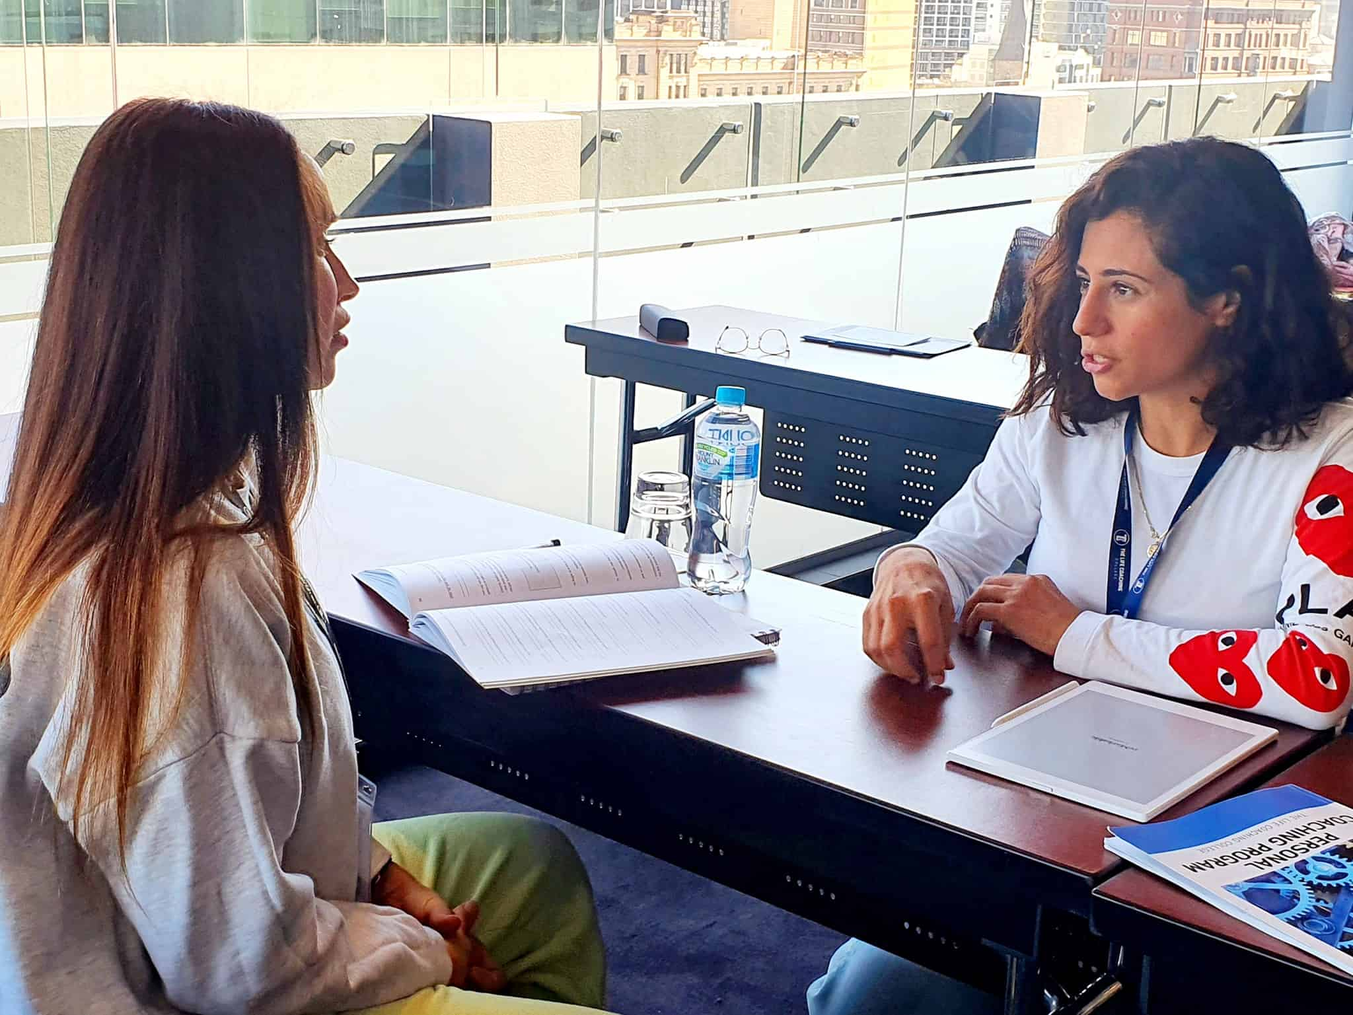
#2 Redirect the Conflict
Use of open-ended coaching questions
Be calm, polite and inform the person you want to listen
Clarify what the source of the conflict is
Notes:
Nothing can be resolved until the conflict is redirected to a constructive conversation. A useful discussion needs to occur for us to de-escalate a conflict. Its not easy to do but this is where you can use a selection of open-ended coaching questions to redirect the conflict into a fruitful conversation.
You want to remain calm and polite and show that you are listening to them or both parties equally.
You will also need to clarify the source of the conflict as this will enable you to understand how the issue came to grow in the first place. Additionally, you will be able to get both parties to consent to what the disagreement is. And to do so, you need to discuss the needs which are not being met on both sides of the issues. Also, you need to warranty mutual understanding. Ensure you obtain as much information as possible on each side’s outlook. Continue asking those coaching questions until you are confident that all the conflicting parties understand the issue. (Refer people to the Coaching Questions for Conflict fact sheet).

Slide 12

#3 Investigate the Situation
Establish
Establish what is causing the conflict
Remain
Remain mutual and remove any biases
Share
Share your point of view and listen to others
Focus
Focus on the real problem
Notes:
After listening to the concerns of both parties, take time, and investigate the case. Do not prejudge or come up with a final verdict on the basis of what you have. Dig deeper and find out more about the happenings, involved parties, the issues, and how people are feeling. Have an individual and confident conversation with those involved and listen in a keen manner to ensure you comprehend their viewpoints. You can do so by summarising their statements and replicating them back to them. Also, try finding any underlying conflict sources which may not be evident or noticeable at fast.

Slide 13

#4 Find a Solution
Work together to find the solution
Be willing to compromise
Stay positive
Show leadership
Avoid blaming
Notes:
After clarifying the source of conflict, talking to both parties, and investigating the situation, you need to sit down with both parties and discuss the common ways you can execute to meet the common goal, which is managing and resolving the matter at hand. Listen, communicate and brainstorm together until you exhaust all options

Slide 14
What if you are unable to resolve conflict?
Seek mediation from others
2. Come and discuss next steps
Come and speak to the VP Socs/Sports, the Student Activities Team
We may be able to advise on temporary or long-term measures to manage your society/club environment
Trusted neutral party – e.g. an uninvolved exec member
VP Socs/Sports
Student Activities Team
SU Staff
3. Escalate to a complaint service (if appropriate)
If the conflict can be resolved informally then please attempt this (or mediation) before escalating to a complaint
We will be looking at the complaints process over the next academic year to make sure it's fit for purpose
Notes:
What is key to resolving and de-escalating conflict is your leadership and the way. You will need to guide the process, you will need to step up to the plate, and it takes a lot of practice. It is not something you are going to learn overnight so be patient with yourself.
Its also important to understand that there may be situations in which even after using the 4 strategies, conflict cannot be resolved. In this this situations you can find further help and support through (OUTLINE THIS).

Slide 15
Notes for Escalation...
Votes of No Confidence
Removal from Society / Club
Must go through the VP Socs or Sports, or not legitimate
The VP Socs/Sports will determine whether there is the threshold for a VONC or if mediation/alternative would be more appropriate
The VP will walk you through the process and attend the VONC to mediate/oversee
Execs do not have the power to remove someone's membership/kick them from the club or society.
This sanction can be recommended and implemented by the investigating Officer for either an SU or University Complaint
Reasons for removal are often concerning welfare or serious misconduct – but each complaint is handled on a case-by-case basis

Slide 16
Difference between complaints...
Report and Support
SU Complaints
Support immediately available upon reporting
Only goes to disciplinary proceedings if the reporter wants it to
If so, investigated by Student Discipline team, and sanctions can be applied
Jurisdiction only extends as far as SU activity
Investigated by one or more Full-Time Officers
Can be handled at:
  Level 1: mediation/resolved informally
  Level 2: investigated by two or more FTOs, results in recommendations
  Level 3: investigated by 3 or more FTOs, results in recommendations
When reporting something that has happened to someone else, you MUST have their permission before reporting.

Slide 17
Activity
Notes:
Provide scenarios and ask them to review and feedback to wider group.

Slide 18
Scenarios
Activity
Using the 4 steps model to resolve the conflict in your given scenario. What will you do in this situation to de-escalate the conflict?
10 mins to look at scenario
15 mins for wider group feedback
Notes:
Emma and Anna to write up two scenarios/situations and insert in the slide.

Slide 19
Scenario one
Scenario 1: In an exec meeting, someone is talking over you, you feel overpowered, and you don't know how to get your point across. What would you do to resolve this situation?
Group 1: You are the person trying to speak
Group 2: You are the person chairing the meeting
Group 3: You receive feedback that you are a talking over another person
Stop and Think --> Redirect the conflict --> Investigate the situation
--> Find a solution
Notes:
Emma and Anna to write up two scenarios/situations and insert in the slide.

Slide 20
Scenario two
Scenario 2: You feel an exec member is not pulling their weight, and it's impacting on your own work and/or the productivity of the exec as a whole. What would you do to resolve this situation?
Group 1: You are the person raising that the other exec member is not pulling their weight
Group 2: You are the mediator/president/team leader who is responsible for the overall direction and organisation of the exec
Group 3: You've received feedback that you're not pulling your weight
Stop and Think --> Redirect the conflict --> Investigate the situation ​
--> Find a solution
Notes:
Emma and Anna to write up two scenarios/situations and insert in the slide.

Slide 21
Scenario three
Scenario 3: A society member has accused an exec member of misconduct
Group 1: Identify one thing to do, why, and how you would do it
Group 2: Identify one thing to avoid and why - what might be the outcome if you were to do it?
Group 3: Who could you approach for advice/signpost to if you don't know how to handle this?
Stop and Think --> Redirect the conflict --> Investigate the situation ​
--> Find a solution
Notes:
Emma and Anna to write up two scenarios/situations and insert in the slide.

Slide 22
Thank you for listening!

